Slide 1
OGT SCIENCE Review

Slide 2
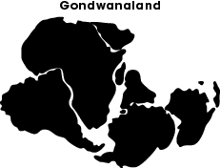
Earth Science
1. Scientists have hypothesized for years that Earth’s continents once formed a single landmass that broke apart and became the continents as we know them today. The model below shows the landmasses (Gondwanaland) as they started to break apart to form South America, Africa, Antarctica, India, and Australia. What evidence best supports the model proposed above?
Igneous rocks have been found on all the continents.
Similar fossils have been found in parts of Africa and South America.
Australia has marsupial species that are not found on other continents.
Indications of sea level changes have been recorded on all the continents

Slide 3
Earth Science
1. Scientists have hypothesized for years that Earth’s continents once formed a single landmass that broke apart and became the continents as we know them today. The model below shows the landmasses (Gondwanaland) as they started to break apart to form South America, Africa, Antarctica, India, and Australia. What evidence best supports the model proposed above?
Igneous rocks have been found on all the continents.
Similar fossils have been found in parts of Africa and South America.
Australia has marsupial species that are not found on other continents.
Indications of sea level changes have been recorded on all the continents

Slide 4
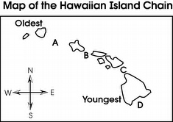
Plate tectonics
2. The Hawaiian Islands are riding on the Pacific Plate as it moves northwestward. They are being formed as the plate moves over a hot spot in the mantle.
Where is the next volcano likely to form?
A
B
C
D

Slide 5
Plate tectonics
2. The Hawaiian Islands are riding on the Pacific Plate as it moves northwestward. They are being formed as the plate moves over a hot spot in the mantle.
Where is the next volcano likely to form?
A
B
C
D

Slide 6
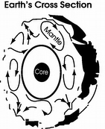
Plate tectonics
3. Scientists believe that forces in Earth’s mantle move Earth’s crustal plates. What do the arrows in the diagram represent?
ocean currents
gravity
convection currents
wind patterns

Slide 7
Plate tectonics
3. Scientists believe that forces in Earth’s mantle move Earth’s crustal plates. What do the arrows in the diagram represent?
ocean currents
gravity
convection currents
wind patterns

Slide 8
Plate tectonics
4. The early development of the theory of plate tectonics was supported by which of these observations?
matching fossils on the continents of Africa and South America
glacier deposits far from existing continental glaciers
thick sediment layers at the mouths of rivers
sudden volcanic activity of long-dormant volcanoes

Slide 9
Plate tectonics
4. The early development of the theory of plate tectonics was supported by which of these observations?
matching fossils on the continents of Africa and South America
glacier deposits far from existing continental glaciers
thick sediment layers at the mouths of rivers
sudden volcanic activity of long-dormant volcanoes

Slide 10
5. An oceanographer is traveling from the west toward the east on the Atlantic Ocean. She collects rock samples from the seafloor every 5 kilometers. The oceanographer stops when she determines that the rock samples are getting progressively younger as she moves toward the east.
What conclusion is best supported by this data?
She is traveling toward a mid-ocean ridge.
She is traveling toward a deep-ocean trench.
She is traveling away from an underwater volcano.
She is traveling away from a hot spot in the crust.

Slide 11
5. An oceanographer is traveling from the west toward the east on the Atlantic Ocean. She collects rock samples from the seafloor every 5 kilometers. The oceanographer stops when she determines that the rock samples are getting progressively younger as she moves toward the east.
What conclusion is best supported by this data?
She is traveling toward a mid-ocean ridge.
She is traveling toward a deep-ocean trench.
She is traveling away from an underwater volcano.
She is traveling away from a hot spot in the crust.

Slide 12
6. Which area is likely the oldest crust?

Slide 13
6. Which area is likely the oldest crust?

Slide 14
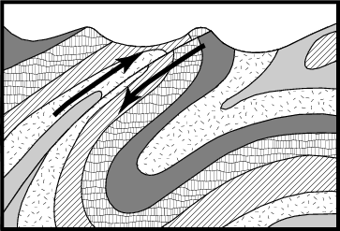
7. What geologic event most likely caused the folding and faulting of these layers?
tectonic activity
glacial advance
magnetic reversal
seafloor spreading

Slide 15
7. What geologic event most likely caused the folding and faulting of these layers?
tectonic activity
glacial advance
magnetic reversal
seafloor spreading

Slide 16
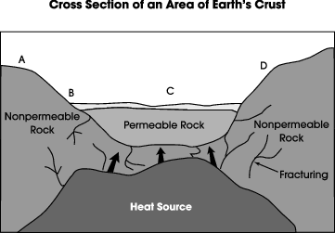
8. In which area of the diagram above is a geyser most likely to form?

Slide 17
8. In which area of the diagram above is a geyser most likely to form?

Slide 18
9. The White Cliffs of Dover are made of a white sedimentary stone called chalk, which was formed when shells and skeletons of small marine organisms were deposited in a thick layer.
An examination of the Cliffs of Dover from top to bottom would show a change from
younger fossils to older fossils.
simple fossils to complex fossils.
igneous rock to sedimentary rock.
marine organisms to land organisms

Slide 19
9. The White Cliffs of Dover are made of a white sedimentary stone called chalk, which was formed when shells and skeletons of small marine organisms were deposited in a thick layer.
An examination of the Cliffs of Dover from top to bottom would show a change from
younger fossils to older fossils.
simple fossils to complex fossils.
igneous rock to sedimentary rock.
marine organisms to land organisms

Slide 20
Space
10. When examining the red shift of galaxies outside our own, every galaxy appears to be moving away from the observer. This observation supports the Big Bang Theory because it indicates that
our galaxy is not moving.
the universe is expanding.
most galaxies have the same mass.
Earth is at the center of the universe.

Slide 21
Space
10. When examining the red shift of galaxies outside our own, every galaxy appears to be moving away from the observer. This observation supports the Big Bang Theory because it indicates that
our galaxy is not moving.
the universe is expanding.
most galaxies have the same mass.
Earth is at the center of the universe.

Slide 22
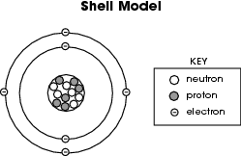
Atomic structure
11.Which element does the shell model represent?

Slide 23
Atomic structure
11.Which element does the shell model represent?

Slide 24
12. The atomic number of carbon is 6, which means that carbon atoms always have 6
ions.
protons.
neutrons.
valence electrons

Slide 25
12. The atomic number of carbon is 6, which means that carbon atoms always have 6
ions.
protons.
neutrons.
valence electrons

Slide 26
13. A metal that can be hammered out or rolled into thin sheets is best described as
brittle.
ductile.
reactive.
malleable

Slide 27
13. A metal that can be hammered out or rolled into thin sheets is best described as
brittle.
ductile.
reactive.
malleable

Slide 28
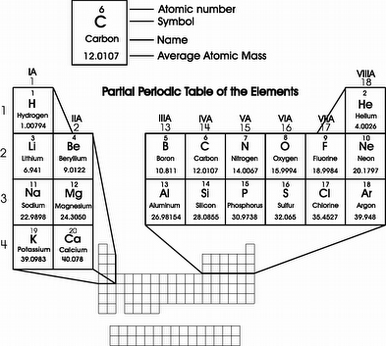
Periodic table
14. A neutral atom of silicon has ______ electrons.

Slide 29
Periodic table
14. A neutral atom of silicon has 14 electrons.

Slide 30
15. Would you normally expect neon (Ne) to form compounds?
Yes, but neon is a rare gas and difficult to obtain.
No, neon needs six electrons to fill its outermost level.
Yes, neon needs six electrons to fill its outermost level.
No, neon has eight electrons in its outermost level and is stable.

Slide 31
15. Would you normally expect neon (Ne) to form compounds?
Yes, but neon is a rare gas and difficult to obtain.
No, neon needs six electrons to fill its outermost level.
Yes, neon needs six electrons to fill its outermost level.
No, neon has eight electrons in its outermost level and is stable.

Slide 32
16. At 25°C, water has a density of 1.0 g/mL and vegetable oil has a density of 0.90 g/mL.
How would a substance with a density of 0.95 g/mL behave when placed in both oil and water?
sink in both oil and water
sink in oil and float on water
float on oil and sink in water
float on both oil and water

Slide 33
16. At 25°C, water has a density of 1.0 g/mL and vegetable oil has a density of 0.90 g/mL.
How would a substance with a density of 0.95 g/mL behave when placed in both oil and water?
sink in both oil and water
sink in oil and float on water
float on oil and sink in water
float on both oil and water

Slide 34
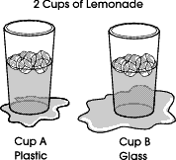
17. Suppose Franklin had a third cup, made of Styrofoam®, to which he added the same number of ice cubes and the same amount of lemonade. What would Franklin expect to observe after 20 minutes?
The Styrofoam cup would have a smaller puddle than either the glass or plastic cup.
The Styrofoam cup would have a larger puddle than either the glass or plastic cup.
The Styrofoam cup would have a puddle exactly the same size as the plastic cup.
The Styrofoam cup would have a larger puddle than the plastic cup but a smaller puddle than the glass cup

Slide 35
17. Suppose Franklin had a third cup, made of Styrofoam®, to which he added the same number of ice cubes and the same amount of lemonade. What would Franklin expect to observe after 20 minutes?
The Styrofoam cup would have a smaller puddle than either the glass or plastic cup.
The Styrofoam cup would have a larger puddle than either the glass or plastic cup.
The Styrofoam cup would have a puddle exactly the same size as the plastic cup.
The Styrofoam cup would have a larger puddle than the plastic cup but a smaller puddle than the glass cup

Slide 36
18. A student walks from inside an air-conditioned building to stand outside on a sunny, sandy beach. The student says that her face and the bottoms of her feet feel warm.
Which statement best describes the thermal energy transfer taking place?
Thermal energy is transferred to her face by radiation, and thermal energy is transferred to the bottoms of her feet by radiation.
Thermal energy is transferred to her face by convection, and thermal energy is transferred to the bottoms of her feet by radiation.
Thermal energy is transferred to her face by radiation, and thermal energy is transferred to the bottoms of her feet by conduction.
Thermal energy is transferred to her face by conduction, and thermal energy is transferred to the bottoms of her feet by conduction

Slide 37
18. A student walks from inside an air-conditioned building to stand outside on a sunny, sandy beach. The student says that her face and the bottoms of her feet feel warm.
Which statement best describes the thermal energy transfer taking place?
Thermal energy is transferred to her face by radiation, and thermal energy is transferred to the bottoms of her feet by radiation.
Thermal energy is transferred to her face by convection, and thermal energy is transferred to the bottoms of her feet by radiation.
Thermal energy is transferred to her face by radiation, and thermal energy is transferred to the bottoms of her feet by conduction.
Thermal energy is transferred to her face by conduction, and thermal energy is transferred to the bottoms of her feet by conduction

Slide 38
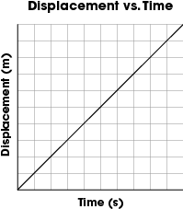
Motion
19. Illustrated below is the change in position of a car every second. Which observation of an object moving from left to right did the student record?

Slide 39
Motion
19. Illustrated below is the change in position of a car every second. Which observation of an object moving from left to right did the student record?

Slide 40
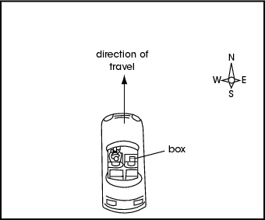
Forces, Newton’s laws
20. A driver is headed north at 50 km/hr. A box is sitting on the seat next to him.
What action by the driver would most likely cause him to observe the box appear to slide to the west?
applying the brakes
speeding up to 60 km/hr
making a turn to the east
making a turn to the west

Slide 41
Forces, Newton’s laws
20. A driver is headed north at 50 km/hr. A box is sitting on the seat next to him.
What action by the driver would most likely cause him to observe the box appear to slide to the west?
applying the brakes
speeding up to 60 km/hr
making a turn to the east
making a turn to the west

Slide 42
21. When dropped from the same height, why does a flat sheet of paper fall more slowly than the same sheet when it is tightly crumpled into a ball?
The sheet of paper has less mass when it is flat than it does when it is crumpled.
The sheet of paper weighs less when it is flat than it does when it is crumpled.
The force of gravity has a greater effect on the crumpled paper than it does on the flat paper.
The flat sheet of paper has greater surface area and encounters more air resistance than when it is crumpled.

Slide 43
21. When dropped from the same height, why does a flat sheet of paper fall more slowly than the same sheet when it is tightly crumpled into a ball?
The sheet of paper has less mass when it is flat than it does when it is crumpled.
The sheet of paper weighs less when it is flat than it does when it is crumpled.
The force of gravity has a greater effect on the crumpled paper than it does on the flat paper.
The flat sheet of paper has greater surface area and encounters more air resistance than when it is crumpled.

Slide 44
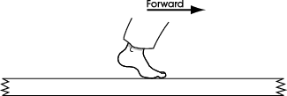
22. Which statement accurately describes the interaction between the foot and sidewalk as a person moves forward along the sidewalk in the direction of the arrow?
The foot pushes forward on the sidewalk; the sidewalk does not push forward on the foot.
The foot pushes forward on the sidewalk; the sidewalk pushes forward on the foot.
The foot pushes backward on the sidewalk; the sidewalk pushes forward on the foot.
The foot pushes backward on the sidewalk; the sidewalk pushes backward on the foot

Slide 45
22. Which statement accurately describes the interaction between the foot and sidewalk as a person moves forward along the sidewalk in the direction of the arrow?
The foot pushes forward on the sidewalk; the sidewalk does not push forward on the foot.
The foot pushes forward on the sidewalk; the sidewalk pushes forward on the foot.
The foot pushes backward on the sidewalk; the sidewalk pushes forward on the foot.
The foot pushes backward on the sidewalk; the sidewalk pushes backward on the foot

Slide 46
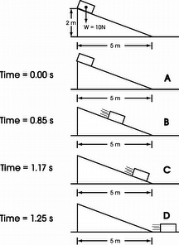
Energy-Potential vs. Kinetic
23. At what time does the box have the greatest kinetic energy?
0.00 s
0.85 s
1.17 s
1.25 s

Slide 47
Energy-Potential vs. Kinetic
23. At what time does the box have the greatest kinetic energy?
0.00 s
0.85 s
1.17 s
1.25 s

Slide 48
24. The total energy of the box is
always the same.
negative at point D.
increasing with time.
zero before the box is released.

Slide 49
24. The total energy of the box is
always the same.
negative at point D.
increasing with time.
zero before the box is released.

Slide 50
25. Where is the potential energy of the box greatest?
The potential energy is constant throughout the motion.
The potential energy is greatest at the top of the incline.
The potential energy is greatest midway along the incline.
The potential energy is greatest at the bottom of the incline.

Slide 51
25. Where is the potential energy of the box greatest?
The potential energy is constant throughout the motion.
The potential energy is greatest at the top of the incline.
The potential energy is greatest midway along the incline.
The potential energy is greatest at the bottom of the incline.

Slide 52
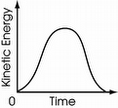
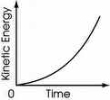
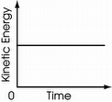
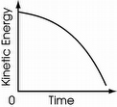
26. Which graph shows the kinetic energy of the space shuttle during the first few minutes of flight? (Launch time = 0)

Slide 53
26. Which graph shows the kinetic energy of the space shuttle during the first few minutes of flight? (Launch time = 0)

Slide 54
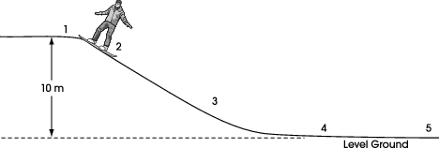
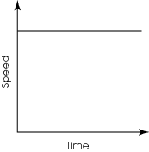
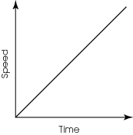
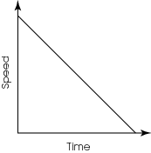
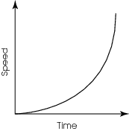
27. Which graph best represents the speed of the snowboarder as he moves from point 2 to point 3?

Slide 55
27. Which graph best represents the speed of the snowboarder as he moves from point 2 to point 3?

Slide 56
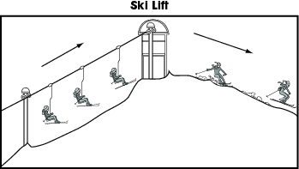
28. Which statement best explains the change in the skier’s potential energy?
The skier loses potential energy as she is lifted up the slope and loses potential energy as she skis down the slope.
The skier gains potential energy as she is lifted up the slope and maintains the same potential energy as she skis down the slope.
The skier gains potential energy as she is lifted up the slope and loses potential energy as she skis down the slope.
The skier loses potential energy as she is lifted up the slope and gains potential energy as she skis down the slope

Slide 57
28. Which statement best explains the change in the skier’s potential energy?
The skier loses potential energy as she is lifted up the slope and loses potential energy as she skis down the slope.
The skier gains potential energy as she is lifted up the slope and maintains the same potential energy as she skis down the slope.
The skier gains potential energy as she is lifted up the slope and loses potential energy as she skis down the slope.
The skier loses potential energy as she is lifted up the slope and gains potential energy as she skis down the slope

Slide 58
29. A student plans to collect data needed to calculate the kinetic energy of a thrown baseball. She plans to measure the distance from pitcher to catcher, the time it takes for the baseball to arrive in the catcher’s glove, the mass of the baseball, and the circumference of the baseball.
Which of these measurements is not needed to calculate the kinetic energy?
measuring the mass of the ball
measuring the flight time of the ball
measuring the circumference of the ball
measuring the distance from pitcher to catcher

Slide 59
29. A student plans to collect data needed to calculate the kinetic energy of a thrown baseball. She plans to measure the distance from pitcher to catcher, the time it takes for the baseball to arrive in the catcher’s glove, the mass of the baseball, and the circumference of the baseball.
Which of these measurements is not needed to calculate the kinetic energy?
measuring the mass of the ball
measuring the flight time of the ball
measuring the circumference of the ball
measuring the distance from pitcher to catcher

Slide 60
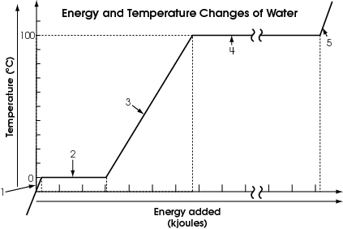
30. Which region of the graph represents water (H₂O) in the liquid form only?

Slide 61
30. Which region of the graph represents water (H₂O) in the liquid form only?

Slide 62
Energy Transfer
31. Which energy transformation below describes the conversion involved when the carbon compounds in wood are burned?
Chemical energy is converted to thermal energy.
Thermal energy is converted to chemical energy.
Potential energy is converted into chemical energy.
Chemical energy is converted into potential energy

Slide 63
Energy Transfer
31. Which energy transformation below describes the conversion involved when the carbon compounds in wood are burned?
Chemical energy is converted to thermal energy.
Thermal energy is converted to chemical energy.
Potential energy is converted into chemical energy.
Chemical energy is converted into potential energy

Slide 64
32. Jackie used a portable electric drill to remove screws from a broken wooden table. He noticed that the screws holding the table together were warm to the touch after being removed from the wood.
What explains this phenomenon?
Mechanical energy from the drill was converted into thermal energy due to friction.
Electrical energy from the drill was converted into chemical energy due to resistance.
Thermal energy from the drill was converted into mechanical energy due to inertia.
The process of removing the screw concentrated the thermal energy that was already present in the wood.

Slide 65
32. Jackie used a portable electric drill to remove screws from a broken wooden table. He noticed that the screws holding the table together were warm to the touch after being removed from the wood.
What explains this phenomenon?
Mechanical energy from the drill was converted into thermal energy due to friction.
Electrical energy from the drill was converted into chemical energy due to resistance.
Thermal energy from the drill was converted into mechanical energy due to inertia.
The process of removing the screw concentrated the thermal energy that was already present in the wood.

Slide 66
Community interactions
33. Rising ocean temperatures can cause corals to expel the symbiotic algae on which they depend for survival.
Which human influence could be responsible for an increase in this phenomenon?
shoreline erosion
burning fossil fuels
solar power generation
introduction of non-native species

Slide 67
Community interactions
33. Rising ocean temperatures can cause corals to expel the symbiotic algae on which they depend for survival.
Which human influence could be responsible for an increase in this phenomenon?
shoreline erosion
burning fossil fuels
solar power generation
introduction of non-native species

Slide 68
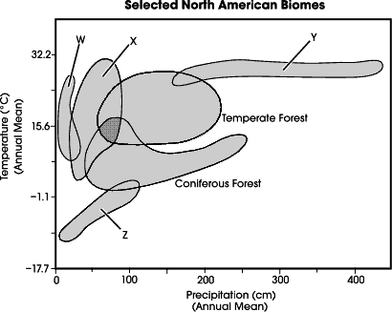
Biomes
34. Deserts are consistently the driest biomes in North America. They typically receive very little precipitation but have a wide variation in the mean annual temperature. Which biome likely represents the deserts?
W
X
Y
Z

Slide 69
Biomes
34. Deserts are consistently the driest biomes in North America. They typically receive very little precipitation but have a wide variation in the mean annual temperature. Which biome likely represents the deserts?
W
X
Y
Z

Slide 70
35. Based on the graph, what is the primary difference between biomes W and X?
mean number of species
mean annual temperature
mean annual precipitation
mean number of
days with sunshine

Slide 71
35. Based on the graph, what is the primary difference between biomes W and X?
mean number of species
mean annual temperature
mean annual precipitation
mean number of
days with sunshine

Slide 72
36. The tundra is the coldest of the biomes, having extremely low temperatures and little precipitation.
What other characteristics would be expected for this biome?
low biotic diversity and sparse vegetation
nutrient rich soil and a long growing season
stable population numbers and high biotic diversity
dense vegetation and large daily temperature fluctuations

Slide 73
36. The tundra is the coldest of the biomes, having extremely low temperatures and little precipitation.
What other characteristics would be expected for this biome?
low biotic diversity and sparse vegetation
nutrient rich soil and a long growing season
stable population numbers and high biotic diversity
dense vegetation and large daily temperature fluctuations

Slide 74
37. Tropical forests typically have a narrow range of temperatures but a wide variation in the amount of rain that falls per year. Additionally, some tropical forests receive nearly twice as much precipitation as other wet biomes.
Which biome represents the tropical forests?

Slide 75
37. Tropical forests typically have a narrow range of temperatures but a wide variation in the amount of rain that falls per year. Additionally, some tropical forests receive nearly twice as much precipitation as other wet biomes.
Which biome represents the tropical forests?
Y

Slide 76
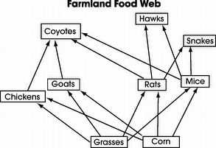
Food webs
38. Many people who raise chickens and other small farm animals consider coyotes to be pests. These people have decreased the coyote population in many parts of the United States. Which of these is likely a result of the decrease in the number of coyotes in the area?
The mouse population has increased.
The hawk population has decreased.
The grass population has increased.
The goat population has decreased.

Slide 77
Food webs
38. Many people who raise chickens and other small farm animals consider coyotes to be pests. These people have decreased the coyote population in many parts of the United States. Which of these is likely a result of the decrease in the number of coyotes in the area?
The mouse population has increased.
The hawk population has decreased.
The grass population has increased.
The goat population has decreased.

Slide 78
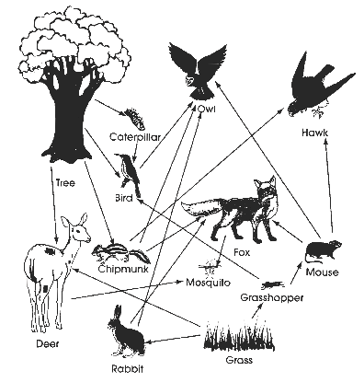
39. Based on this diagram, an ecologist would most likely conclude that a decrease in the fox population would result in
an increase in the owl population.
a decrease in the rabbit population.
a decrease in the chipmunk population.
an increase in the grasshopper population.

Slide 79
39. Based on this diagram, an ecologist would most likely conclude that a decrease in the fox population would result in
an increase in the owl population.
a decrease in the rabbit population.
a decrease in the chipmunk population.
an increase in the grasshopper population.

Slide 80
40. A student has set up an artificial ecosystem for a class project. This ecosystem has producers, first-level consumers, second-level consumers, and third-level consumers. By accident, a chemical enters the ecosystem and kills all of the first-level consumers.
Which group(s) of organisms will most likely survive?
producers
second-level consumers
second-level and third-level consumers
third-level consumers and producers

Slide 81
40. A student has set up an artificial ecosystem for a class project. This ecosystem has producers, first-level consumers, second-level consumers, and third-level consumers. By accident, a chemical enters the ecosystem and kills all of the first-level consumers.
Which group(s) of organisms will most likely survive?
producers
second-level consumers
second-level and third-level consumers
third-level consumers and producers

Slide 82
41. A simple food chain in a wetland is represented below.
An ecologist doing population counts in the wetland observes a drop in the number of trout over an extended period of time.
What change is most likely responsible for the trout decline?
migration of blue herons out of the wetland area
introduction of a predator that feeds on blue heron eggs
application of insecticides to wet areas where mosquitoes breed
implementation of new conservation laws to protect the wetland

Slide 83
41. A simple food chain in a wetland is represented below.
An ecologist doing population counts in the wetland observes a drop in the number of trout over an extended period of time.
What change is most likely responsible for the trout decline?
migration of blue herons out of the wetland area
introduction of a predator that feeds on blue heron eggs
application of insecticides to wet areas where mosquitoes breed
implementation of new conservation laws to protect the wetland

Slide 84
Cells
42. A scientist uses a microscope to examine two slides of living bacteria. Each slide contains a different type of bacteria. While the cells on the first slide are moving rapidly, the cells on the second slide are stationary. Based on these observations, the cells on the second slide most likely have no…
nucleus.
flagella.
chloroplasts.
mitochondria

Slide 85
Cells
42. A scientist uses a microscope to examine two slides of living bacteria. Each slide contains a different type of bacteria. While the cells on the first slide are moving rapidly, the cells on the second slide are stationary. Based on these observations, the cells on the second slide most likely have no…
nucleus.
flagella.
chloroplasts.
mitochondria

Slide 86
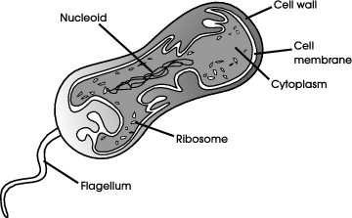
43. The presence of which structure provides evidence that this organism is capable of locomotion?
cell wall
ribosome
flagellum
cytoplasm

Slide 87
43. The presence of which structure provides evidence that this organism is capable of locomotion?
cell wall
ribosome
flagellum
cytoplasm

Slide 88
44. What structure is absent in the cells of fungi thereby preventing them from performing photosynthesis?
cilia
nuclei
chloroplasts
mitochondria

Slide 89
44. What structure is absent in the cells of fungi thereby preventing them from performing photosynthesis?
cilia
nuclei
chloroplasts
mitochondria

Slide 90
Cell processes
45. What gas does the process of photosynthesis release into the atmosphere?
carbon dioxide
hydrogen
nitrogen
oxygen

Slide 91
Cell processes
45. What gas does the process of photosynthesis release into the atmosphere?
carbon dioxide
hydrogen
nitrogen
oxygen

Slide 92
46. Energy produced by cellular processes is stored as
CO₂.
ATP.
DNA.
RNA

Slide 93
46. Energy produced by cellular processes is stored as
CO₂.
ATP.
DNA.
RNA

Slide 94
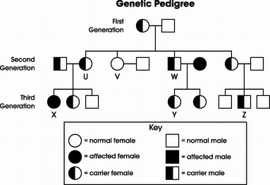
Genetics
47. In the genetic pedigree, person U and her husband are considering having another child. What is the percent chance that this child will develop sickle cell disease?
25%
50%
75%
100%

Slide 95
Genetics
47. In the genetic pedigree, person U and her husband are considering having another child. What is the percent chance that this child will develop sickle cell disease?
25%
50%
75%
100%

Slide 96
48. Which person on the pedigree could not pass the allele for sickle cell disease to his/her offspring?
V
X
Y
Z

Slide 97
48. Which person on the pedigree could not pass the allele for sickle cell disease to his/her offspring?
V
X
Y
Z

Slide 98
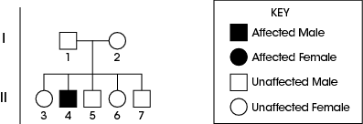
49. Based on the inheritance pattern, what are all the possible genotypes for individual 6?
Zz
ZZ and zz
ZZ and Zz
ZZ, Zz and zz

Slide 99
49. Based on the inheritance pattern, what are all the possible genotypes for individual 6?
Zz
ZZ and zz
ZZ and Zz
ZZ, Zz and zz

Slide 100
50. Color blindness is a sex-linked trait that is carried on the X chromosome. If a boy is born color-blind, what would have to be true?
His father had normal vision.
His grandmother was color-blind.
His mother carried at least one gene for color blindness.
His grandfather passed on the color-blind trait to his father

Slide 101
50. Color blindness is a sex-linked trait that is carried on the X chromosome. If a boy is born color-blind, what would have to be true?
His father had normal vision.
His grandmother was color-blind.
His mother carried at least one gene for color blindness.
His grandfather passed on the color-blind trait to his father

Slide 102
Evolution
51. Geneticists have determined that the majority of individuals in an isolated island population have blood type B. Type A blood is found to be more common in the mainland population from which the island was settled.
How could a geneticist best explain the dominance of blood type B in the island population?
Random mutations have occurred in the island population.
Genetic drift has reduced the frequency of type A individuals.
Natural selection has only occurred in the mainland population.
Environmental conditions on the island are less favorable for type B individuals

Slide 103
Evolution
51. Geneticists have determined that the majority of individuals in an isolated island population have blood type B. Type A blood is found to be more common in the mainland population from which the island was settled.
How could a geneticist best explain the dominance of blood type B in the island population?
Random mutations have occurred in the island population.
Genetic drift has reduced the frequency of type A individuals.
Natural selection has only occurred in the mainland population.
Environmental conditions on the island are less favorable for type B individuals

Slide 104
52. Due to a loss of habitat, hunting, drought, disease, and inbreeding, the cheetah population has declined in number and is close to extinction. The current cheetah population has very little genetic variation. Which is a result of the limited genetic variation in the current cheetah population compared to earlier cheetah populations with more variation?
Current populations of cheetahs are more resistant to diseases.
The survival rate of young cheetahs is increased in current populations.
Current populations of cheetahs are less likely to be able to adapt to environmental changes.
Current populations of cheetahs are able to interbreed with other species, increasing genetic variation.

Slide 105
52. Due to a loss of habitat, hunting, drought, disease, and inbreeding, the cheetah population has declined in number and is close to extinction. The current cheetah population has very little genetic variation. Which is a result of the limited genetic variation in the current cheetah population compared to earlier cheetah populations with more variation?
Current populations of cheetahs are more resistant to diseases.
The survival rate of young cheetahs is increased in current populations.
Current populations of cheetahs are less likely to be able to adapt to environmental changes.
Current populations of cheetahs are able to interbreed with other species, increasing genetic variation.

Slide 106
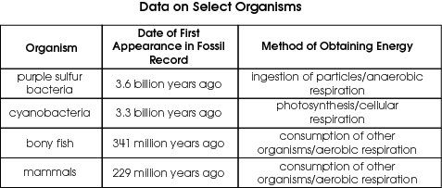
53. The appearance of which organism contributed the most to making it possible for humans and other organisms to breathe Earth’s current atmosphere?
A) bony fish
B) mammals
C) cyanobacteria
D) purple sulfur bacteria

Slide 107
53. The appearance of which organism contributed the most to making it possible for humans and other organisms to breathe Earth’s current atmosphere?
A) bony fish
B) mammals
C) cyanobacteria
D) purple sulfur bacteria

Slide 108
Classification
54. Aristotle was the first person to classify living organisms and did so using a two-kingdom system involving a plant group and an animal group. The system used today is much more useful to scientists because the two-kingdom system did not
recognize the similarities within the plant group.
separate living things based on characteristics and traits.
allow for the placement of human beings in its classification.
include many organisms such as those later discovered with microscopes.

Slide 109
Classification
54. Aristotle was the first person to classify living organisms and did so using a two-kingdom system involving a plant group and an animal group. The system used today is much more useful to scientists because the two-kingdom system did not
recognize the similarities within the plant group.
separate living things based on characteristics and traits.
allow for the placement of human beings in its classification.
include many organisms such as those later discovered with microscopes.

Slide 110
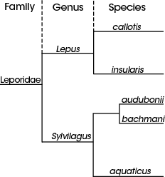
55. Which two species are most similar?

Slide 111
55. Which two species are most similar?

Slide 112
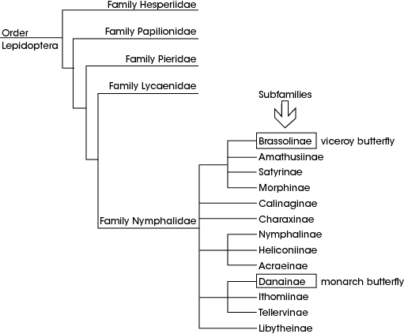
56. Based on this diagram, monarchs and viceroys belong to the same
genus.
family.
species.
subfamilies

Slide 113
56. Based on this diagram, monarchs and viceroys belong to the same
genus.
family.
species.
subfamilies

Slide 114
57. For many years scientists debated whether viruses should be considered living organisms.
Which statement could a scientist use to support the position that viruses are not living?
Viruses have genes encoded in DNA.
Viruses require a host cell in order to reproduce.
Viruses infect both plant and animal cells.
Viruses replicate to produce more viruses.

Slide 115
57. For many years scientists debated whether viruses should be considered living organisms.
Which statement could a scientist use to support the position that viruses are not living?
Viruses have genes encoded in DNA.
Viruses require a host cell in order to reproduce.
Viruses infect both plant and animal cells.
Viruses replicate to produce more viruses.

Slide 116
58. A student is studying several species that belong to the plant kingdom. Which two are most closely related?
Ficus benjamina and Ficus lyrata
Castilla elastica and Ficus elastica
Bromus japonicus and Ipomoea violacea
Fermaldia pandurata and Ficus pandurata

Slide 117
58. A student is studying several species that belong to the plant kingdom. Which two are most closely related?
Ficus benjamina and Ficus lyrata
Castilla elastica and Ficus elastica
Bromus japonicus and Ipomoea violacea
Fermaldia pandurata and Ficus pandurata

Slide 118
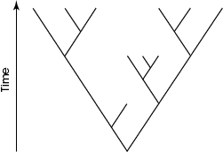
59. This branching tree diagram is most likely used to represent the theory that suggests
new species arise throughout time following rounds of mass extinction.
all species share a common ancestor and that change occurs through time.
speciation occurs very quickly with long periods of no change in between.
all species originated during the same period and some have subsequently gone extinct.

Slide 119
59. This branching tree diagram is most likely used to represent the theory that suggests
new species arise throughout time following rounds of mass extinction.
all species share a common ancestor and that change occurs through time.
speciation occurs very quickly with long periods of no change in between.
all species originated during the same period and some have subsequently gone extinct.

